Slide 1
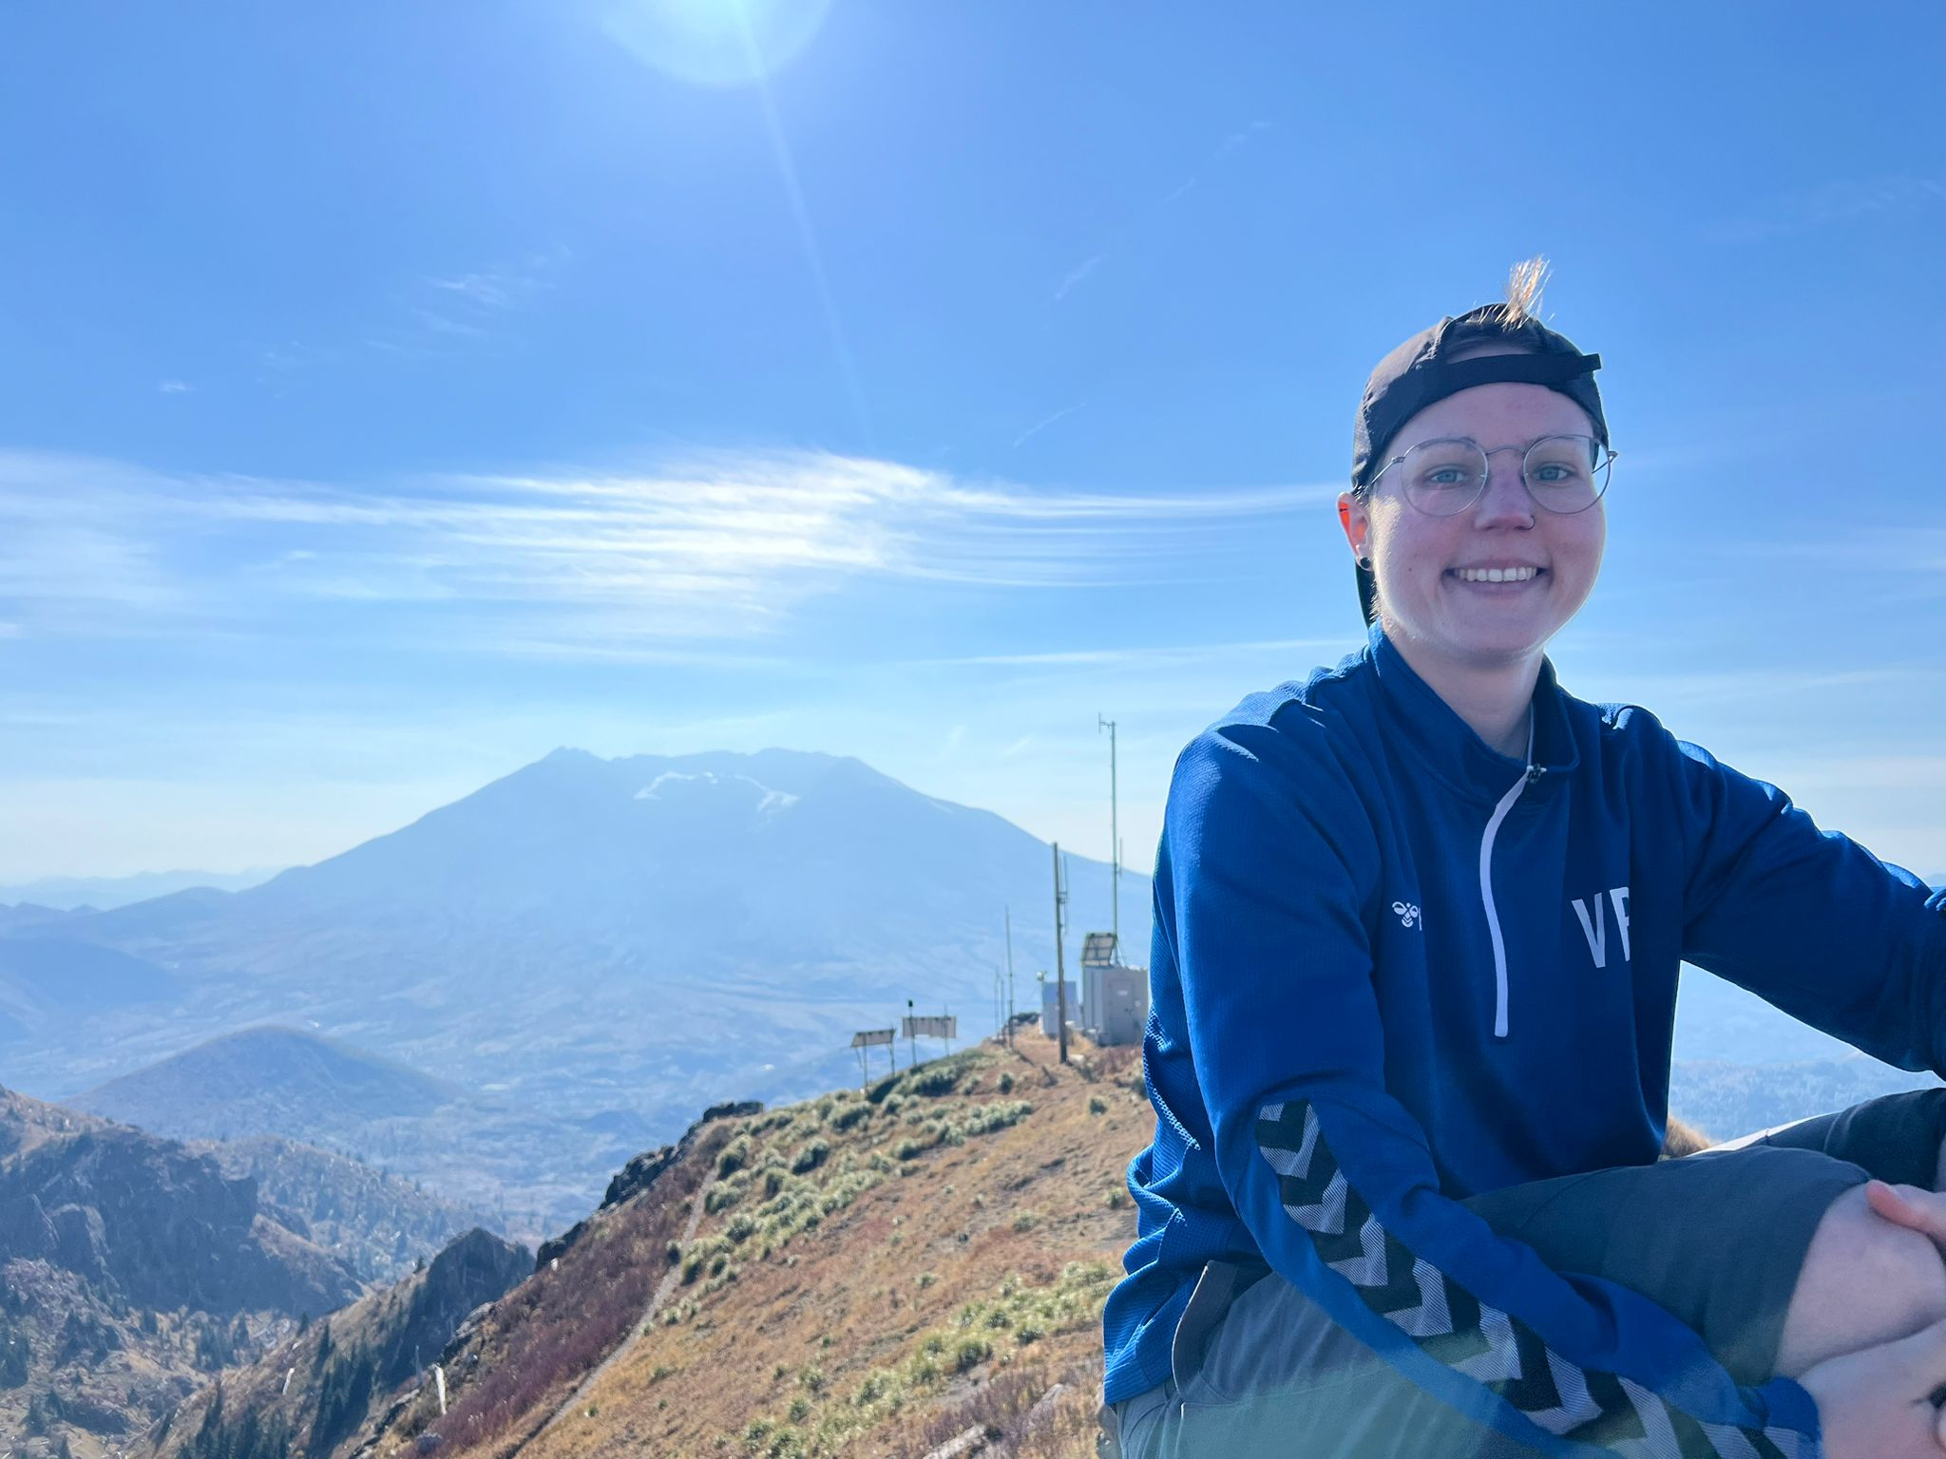
Veronika Betzel
Mental Health at work
Notes:
Hello and welcome to my talk.

Slide 2
We need to talk…(more)about Mental Health at work
Notes:
Hello and welcome to my talk.
And: We need to talk
We need to talk more about mental health at work.
And this is exactly the topic I will start today and present to you
ATMEN
Before I start taking you on my journey, I would like to get you an idea of the person on the stage.
This will be the long version of my talk, which I have never done before and it should take not more then 40 minutes. So there will be time for questions and/or discussions afterwards.
NÄCHSTE FOLIE

Slide 3
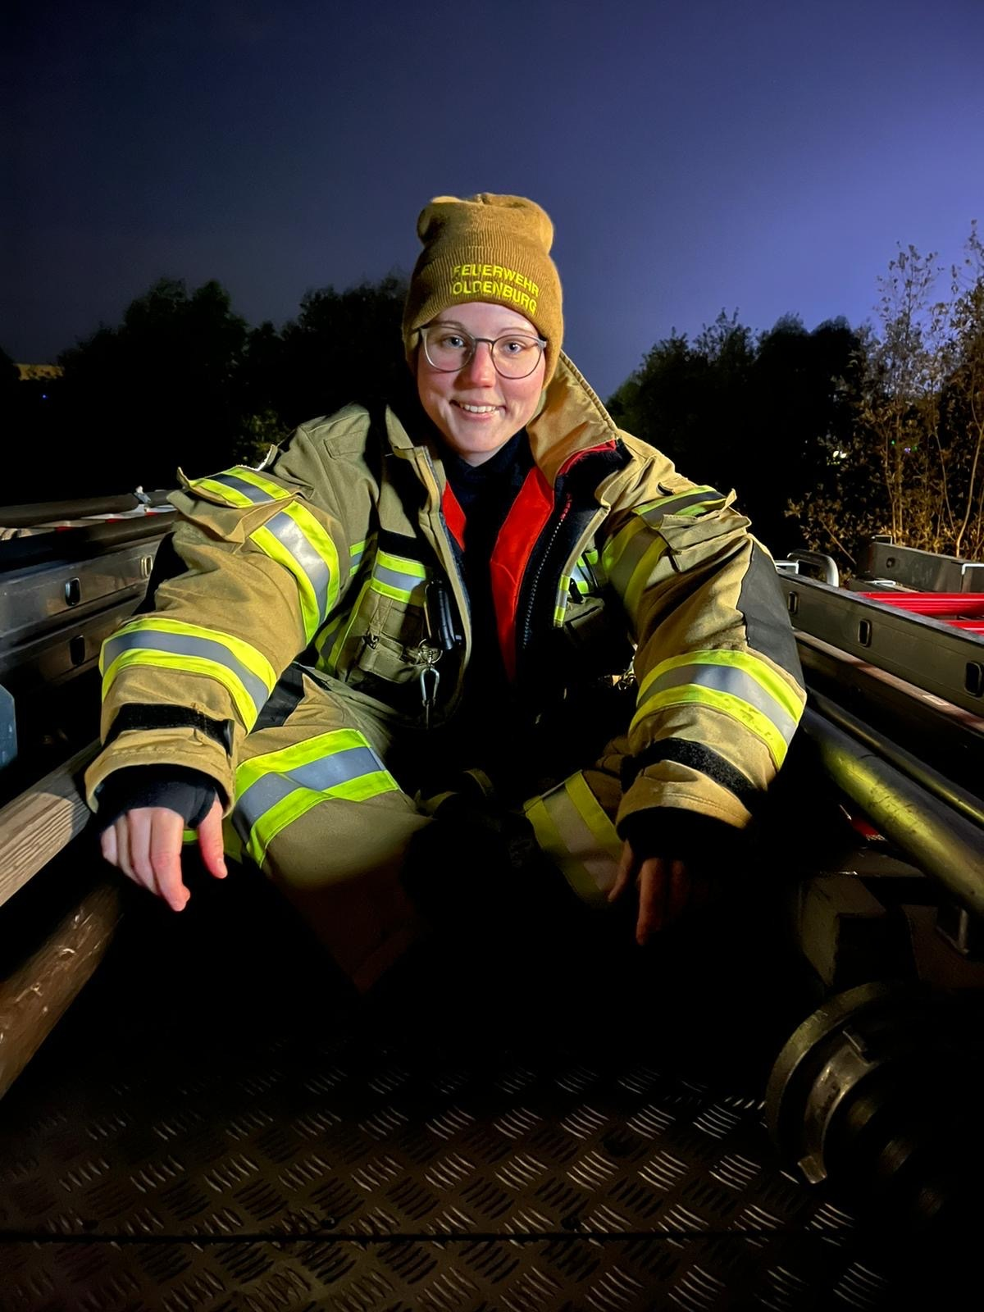
Veronika Betzel
Job
Trainer and Consultant at trending
Experience
studied to become a teacher
2017 as a working student
full-time employee since 2019
Private Life
Volunteer firefighter
Soccer
Calisthenics/Crossfit
Gaming
Notes:
So, My name is Veronika Betzel and I’m living currently in Northern Germany.
KLICK
Originally, I studied to become a teacher for mathematics and politics-economy.
During this time I worked as a working student since 2017.
There I discovered my passion for QA and moved in as a full-time employee in 2019
Then I changed my job twice in the past few years
KLICK
And that’s where I’m currently working: As a trainer and consultant at trending technology services GmbH
Klick
I also got a bunch of hobbies, just to mention some:
You cannot unsee it: being a volunteer firefighter
Playing soccer as midfielder at a small fun soccer team
Calisthenics and Crossfit
And in between, I like gaming on PC
NÄCHSTE FOLIE

Slide 4
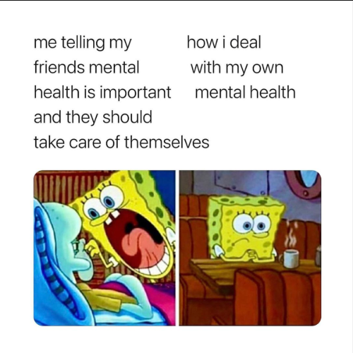
Content Warning
Mental Illnesses
Depression
Anxiety
ADHD
Others
Sarcasm
Bad Jokes and Memes
Menti incoming! Grab your phone
Notes:
Content Warnings for you
I know that this can be controversial in Talks but I just want to make sure that everyone in this room have the capacity to hear something about
KLICK
Mental Illnesses
such as
KLICK
Depression
KLICK
Anxiety
KLICK
ADHD
KLICK
and other
And also got some open space for
KLICK
Sarcasm
and
KLICK
Bad Jokes and a lot of memes
NÄCHSTE FOLIE

Slide 5
Switching to mentimeter…
Notes:
Now I would start with the second promised question
Do you talk about it in the work related context?
By “it” I mean about psychological stress or mental health problems
…
If there is a discrepancy: Say so
If not: That was not what I thought but it still can be seen that we have a discrepancy here.
NÄCHSTE FOLIE

Slide 6
3 4 slides why…
Notes:
And what I want to say about that topic: We need to talk more about mental health in work
And here are 4 slides why this is important and why we should talk about it more often and openly
NÄCHSTE FOLIE

Slide 7
Source: https://www.siemens-energy.com/global/en/home/stories/breaking-the-silence-on-mental-health.html?gclid=Cj0KCQjwuZGnBhD1ARIsACxbAVizlyvAvnYdnopUOrxSV_mXbfbSgzPKnETn_sOP9yIATi90IOjwBZwaArBnEALw_wcB
Notes:
First of all:
How many people are affected by the topic
1 person in 8 worldwide lives with a mental health issue
ATMEN
That’s 12,5%
Every 8th person in this room
So what I want to make clear with this slide is again how many people are affected by it
NÄCHSTE FOLIE

Slide 8
Would you talk openly about psychological stress at work?
37%
27%
18%
10%
8%
I’m open to it
With HR/Leader
With colleagues I trust
No way! / I’m not sure
Just if there will be a change
Source: https://www.linkedin.com/posts/shitshow_neues-ausbildungsprogramm-unser-mental-health-activity-6998256195564150784-9XEj/?utm_source=share&utm_medium=member_desktop
Notes:
Seems like the same question I asked you before but done by a bigger company called Shitshow. They asked around 600 people at Talks and that was the outcome
I think we can all agree that everyone got something to talk about and we know that at least 1/8 got a mental health problems
We can also agree that talking would make it better or at least the behaviour as a result of different things more understandable for others
With this in mind:
Only 8% would talk openly about psychological stress at work
27% would say: No way! or they are really unsure about it
and 10% wants a change to do this
NÄCHSTE FOLIE

Slide 9
Source: https://www.linkedin.com/posts/shitshow_neues-ausbildungsprogramm-unser-mental-health-activity-6998256195564150784-9XEj/?utm_source=share&utm_medium=member_desktop
Notes:
There is a word for it.
Sanism
DRAMATISCHE PAUSE
A form of discrimination and oppression against people based on presumed mental type, mental action, supposed intelligence or neurology, especially against those with a mental disorder or a mental illness.
ATMEN
And why did it exist?
Because people think there is some kind of “normal” person that exist and how the brain should work and everything else is some kind of “not normal”
ATMEN
How can this affect the workplace?
Employers don’t hire persons who are in this stereotype
Fewer opportunities for advancement
Nobody talks about it
Sooo -> We need to talk about it to break the stereotype
NÄCHSTE FOLIE

Slide 10
Mental Health Bullshit-Bingo
Grin and Bear it.
Tomorrow is a new day.
You overthink.
Don’t be such a whimp.
It’s just another fashionable illness.
You just have to want it.
Don’t get yourself so worked up.
Others are much worse off.
You don’t look sick at all.
It didn’t use to exist back then.
Get your butt in gear.
It’s probably from stress.
Pull yourself together.
Everyone has been sad at some point.
Think positively.
You must have too much free time.
Notes:
ATMEN
I added a forth slide this morning that was laying around for a long time
I decided this after the talk from Caleb I’ve heard this morning
This is a bingo
But not just any bingo: It is a Mental Health Bullshit Bingo
Why bullshit? These are and sorry (not sorry) for reusing it: a bullshit bingo of phrases in the world of Mental Health.
ATMEN
Hands up, who of you have heard at least one of these sentences?
I could!
And I loooove some of them, my favorite: You don’t look sick at all.
ATMEN
So (warning this could be sarcasm)
I will just pull myself together and continue with this talk
ATMEN
I told you there will be four main reasons why we should talk about for me
But i lied
There are 5
NÄCHSTE FOLIE

Slide 11
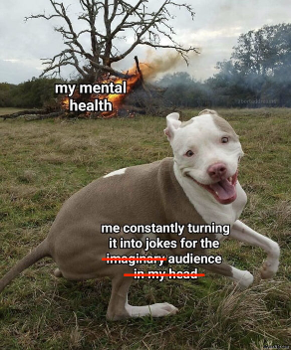
Social Anxiety
Thinking about every social activity before, during and after it
Trying things often by myself rather than asking
Depression
Dejected
Distracted
Emotional
ADHD
1000 thoughts at once
Impulsive
Unfocused
Impatient
Notes:
This will be the most personal slide in my whole talk
But I want to be this open to show what different things can make with people and also to give you more personal understanding why it is an important thing for me
So I want that we talk open about diseases and who would I be if I wouldn’t do it
I can say that I am 100% someone who would fit into the scheme of “Sanism”
At the moment you see my brain working on like every second (also now) if I’m not sleeping
KLICK
This is my ADHD
And I just wrote down a view side effects that it can have to my workplace:
As shown again in the picture: A lot of thoughts at once just hopping into my brain – imagine a browser with constantly 300 tabs open, at least 3 of them are playing music
It could also lead me to acting impulsive, being unfocused (because of the 300 tabs – and the music)
And sometimes others get the feeling that I am really impatient – although there was just another tab opened in brain
ATMEN
NÄCHSTE FOLIE

Slide 12
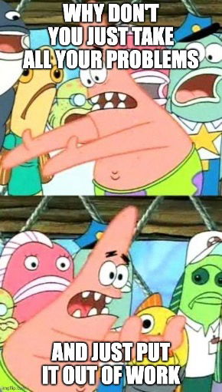
And just let it make your work better
Notes:
And that is just me and I’m not the only one on this planet with ADHD or other squad members
Some other could have stronger or different symptomes
And now we have this problem:
We have like 8 hours more a less a day at work, so what can we do with those feelings?
So, why don’t we change from this meme to
CLICK
this version of the meme?
And now the second part of my talk
NÄCHSTE FOLIE

Slide 13
Myself
Colleagues
Employer
Notes:
I told you
Why it is important to talk about it
Why we should talk about it in work related context.
And now, I want to give you ideas how this can be possibly done, communicated and achieved.
I structured it in three groups:
KLICK
Myself -> So, how can I improve my workspace so that it fits for me
KLICK
Colleagues -> What can they do to build a supportive workplace culture
KLICK
Employer -> How can the employer support?
NÄCHSTE FOLIE

Slide 14
What can I do for myself?
Notes:
What can I do?
To make this improvement in the work related context.
NÄCHSTE FOLIE

Slide 15
Idea #1
Self Organization
Can lead to better mental health at work
Reducing stress
Increasing productivity
Enhancing time management
Allocating time for free time better
Notes:
My first idea, sounds very simple: Self Organization
Why that?
It can lead to better mental health at work by reducing sress, increasing productivity, enhancing time management and allocating time for free time better
especially if you work in a working environment with trust working hours
NÄCHSTE FOLIE

Slide 16
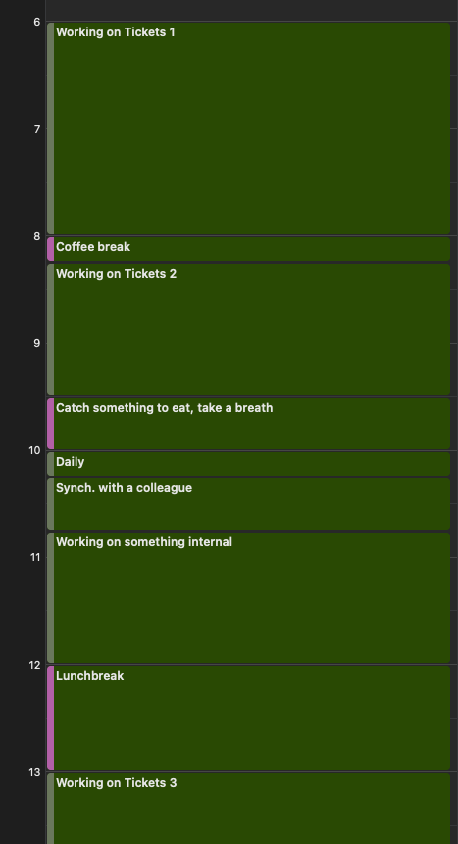
Idea #1
Notes:
So making it more concrete: A normal work day could look like this
I start normally at around 6am, doing some preparation, something for the customer or just for my internal work
After around 2 hours making a small break and then continuing to work
If I have a training, it would be a little different, but I am still trying to make a lot of little breaks also for the participants
And f I need to listen, I always got something to play with my finger like a ring or something to keep concentration high
Making a quick breakfast break before the dailies, having some synching with colleagues and after that working on something internal like a talk
Making a big lunchbreak and then working again for the project till free time
And that’s it!
NÄCHSTE FOLIE

Slide 17
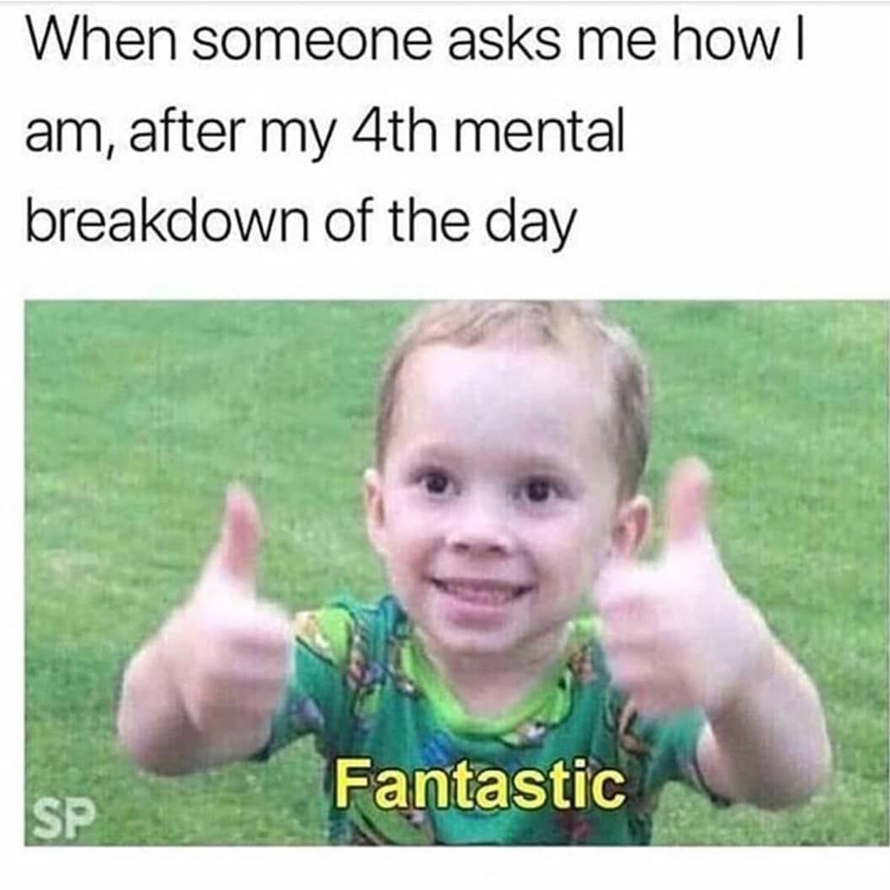
Idea #2
Listen to yourself
What do you need?
What are your feelings? -> Don’t ignore them at work!
Take breaks if needed
Being sick because of an urgent mental health problem is also okay
Notes:
Idea no 2.
Is almost quite similar to the first but so important, that I just want to point it out.
Listen to yourself
Ask yourself questions like:
What do I need?
What are my feelings?
Take breaks if needed
And keep in mind that being sick because of an urgent mental health problem is just the same as being sick because of something visible!
NÄCHSTE FOLIE

Slide 18
Idea #3
Burnout vs. Boreout
Notes:
Idea no 3
Not directly an idea but something that is very important regarding work
Burnout vs Boreout
What does it is exactly?
NÄCHSTE FOLIE

Slide 19
Idea #3
Burnout | Boreout
Definition: State of extrem exhaustion due to chronic work-related stress Causes: Arises from prologned overload, excessive job demands and lack of adequate recovery Symptoms: Emotional exhaustion, depersonalization and a sense of reduced personal accomplishment | Definition: Refers to the feeling of boredum and underutilization at the workplace Causes: A person feels that their skills are not adequately utilized or tasks are too unchallenging Symptoms: Boredom, disinterist in work, lack of energy and frustration
Notes:
Burnout is a state of extrem exhaustion due to chronic work-related stress
It could arise from prolonged overload, excessive job demands and a lack of adequate recovery
Feelable it is by emotional exhaustion and some other things.
Boreout refers to the feeling of boredum at a workplace
It could arise from the feeling that the the skills are not adequately used or tasks are too easy
Symptoms are such as boredom or disinterest
ATMEN
NÄCHSTE FOLIE

Slide 20
Idea #3
Burnout vs. Boreout
Negative impact in well-being
Reduced job satisfaction
Impaired job performance
Potential for physical symptoms
Impact on relationships
Increased risk for mental health issues
Workplace dissatisfaction
Notes:
And both of them have some kind of negative impacts not only in the workplace but also in private
just to mention some here
such as impact on relationships and a reduced job performance
And what is the concrete idea for that?
NÄCHSTE FOLIE

Slide 21
Idea #2 #4
Listen to yourself
What do you need?
What are your feelings? -> Don’t ignore them at work!
Take breaks if needed
Being sick because of an urgent mental health problem is also okay
Notes:
Back to idea 2
I mean forward to idea 4
Listen to yourself
Take care of yourself
and Look out for symptoms
NÄCHSTE FOLIE

Slide 22
Idea #5
Communication
Starting point for a supportive workplace atmosphere
Communicate your Needs and Feelings
Notes:
And my last idea for this part: Idea no 5
Communication
Why? Because it is a starting point for a supportive workplace atmosphere.
What is the similarity of my ideas from before?
You need to communicate them with your feelings and needs because without it no one will know how you feel or what you need
NÄCHSTE FOLIE

Slide 23
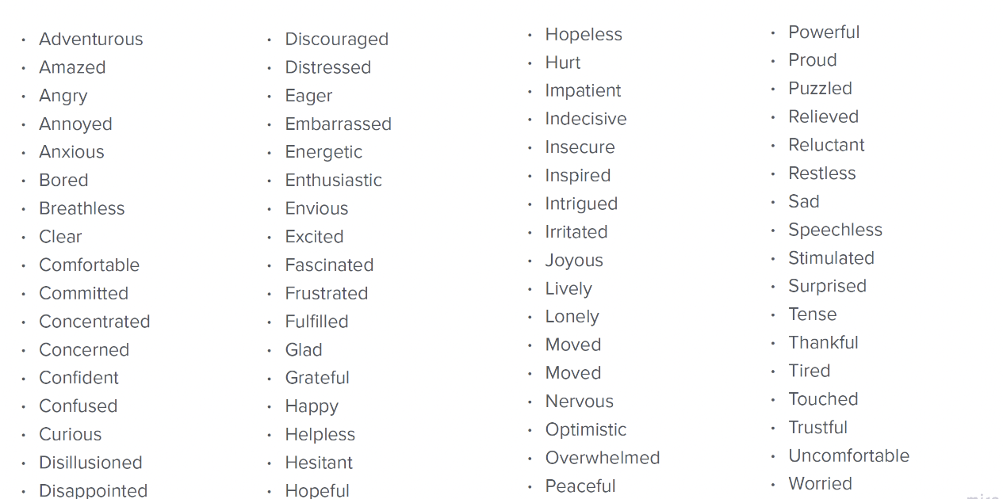
Idea #5
Possible Feelings
Notes:
Possible feelings could be
GIVE A FEW EXAMPLES
NÄCHSTE FOLIE

Slide 24
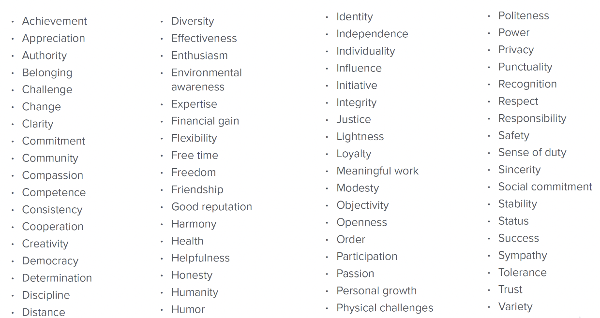
Idea #5
Possible Needs
Notes:
Possible needs could be
GIVE A FEW EXAMPLES
There are also some models to communicate such feelings and needs (like for example the non violent communication if some of you have heard of it) in I would say good ways
But that would be too much for this 20 minutes talk
NÄCHSTE FOLIE

Slide 25
Idea #5
Digression
Notes:
At this point, I want to give a little digression about a topic, I really like
It is a topic about communication
A topic about: How can I communicate with my feelings and MY needs without making it unprofressional
And the answer is:
NÄCHSTE FOLIE

Slide 26
Idea #5
Non-violent communication
EXAMPLE:
“When I see that this evening you are going out without me and it is the third time this week you do it, I feel sad because I need company. Could you please eat dinner with me tomorrow evening?”
Notes:
“Non-violent communication”
And I want to give you a quick and short overview of it
CLICK
So for starting with non violent communication, the first thing would be the observation without interpretation
the second point would be your feelings separated from the thoughts
the third point would be the need instead of strategies
and the last thing would be the request instead of a demand
CLICK
A neutral example would look something like this:
“When I see that this evening you are going out without me and it is the third time this week you do it, I feel sad because I need company. Could you please eat dinner with me tomorrow evening?”
NÄCHSTE FOLIE

Slide 27
Idea #5
Non-violent communication
Example from work
Imagine the following situation:
You are working on a ticket, retesting it. It’s not your best day. You are happy, that you can just test without many interaction today and you are almost off for the weekend. It was talked to your leader that you will leave at 12 and after that you got a representative for urgent task. Your leader comes in the room and says that there is a very urgent appointment that has to take place before the weekend and should be now and because you are here and you can work a few minutes longer it is not necessary that your representative will take part.
Option A: Go to the meeting
Option B: Don’t go to the meeting
Notes:
And just to take all the possible confusion from you, I want to give a work related example.
Imagine the following situation:
You are working on a ticket, retesting it. It’s not your best day. You are happy, that you can just test without many interaction today and you are almost off for the weekend. It was talked to your leader that you will leave at 12 and after that you got a representative for urgent task. Your leader comes in the room and says that there is a very urgent appointment that has to take place before the weekend and should be now and because you are here and you can work a few minutes longer it is not necessary that your representative will take part.
Now you got 2 options:
CLICK
Option A: Go to the meeting
CLICK
Option B: Don’t go to the meeting
And hearing that example the logic and doable way should be Option B.
NÄCHSTE FOLIE

Slide 28
Idea #5
Non-violent communication
How can Option B be communicated?
When I see that you really need someone to participate in this meeting , therefore I organized a representative for my early leave to the weekend. I feel tired from the week because I already did some overtime to completing some tasks and need some tolerance here. Could you please ask my representative if he could go earlier in this meeting?
Notes:
So how can this be communicated to the leader?
CLICK
Like this for example:
When I see that you really need someone to participate in this meeting , therefore I organized a representative for my early leave to the weekend. I feel tired from the week because I already did some overtime to completing some tasks and need some tolerance here. Could you please ask my representative if he could go earlier in this meeting?
NÄCHSTE FOLIE

Slide 29
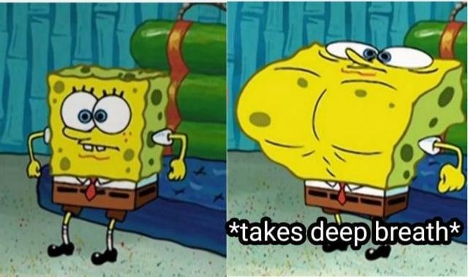
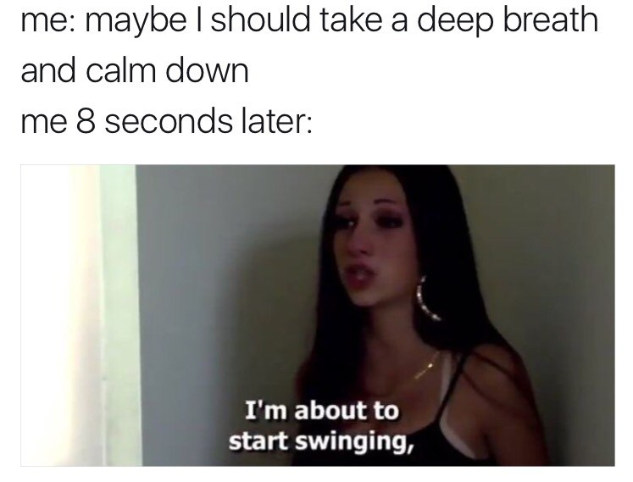
Notes:
So this was the little digression and theoretical part of my talk.
Because that me and you do not forget, just taking a deep breath
And I will continue with my second part.
NÄCHSTE FOLIE

Slide 30
What can I do as a colleague?
Notes:
That were just a few ideas what you can do
But of course is a lot based on social interactions like also communication,
And I’ve told you there are three parts, we need to take a deeper look into.
so the big question is
How can others support to build a supportive workplace culture?
NÄCHSTE FOLIE

Slide 31
Idea #1
(Supportive) Communication
Is a two-side thing
Can not only work if one person is communicating ”correctly”
Notes:
Starting again with idea no 1
supportive communication as the other side of the communication
because
communication is a two-side thing
and it will not only work if one person is communicating “correctly”
So, what are possible strategies?
NÄCHSTE FOLIE

Slide 32
Idea #1
Supportive Communication
Setting Boundaries
Active Listening
Possible Strategies
Non-Judgmental Attitude
Empathy
Notes:
Possible Strategies could be
CLICK
Active Listening
Give the speaker full attention (nodding is also active listening)
So for example if you think the same during my talk as I describe something and you nod like this
Avoid interrupting…
CLICK
Setting Boundaries
Be clear about your own
Respect the boundaries of others
For example: If I want to prepare a talk properly, I need some focus and for the focus, I cannot be interrupted. Some music is nice for me but not talks.
Therefore I set a blocker on my Slack for this deep focus period which I want to be respected by others
CLICK
Non-Judgmental Attitude
Avoid making judgements
Every time a person is doing something the way the person is doing it, there is always a reason behind it, and before being judgemental maybe ask if it is necessary.
For example if a person is late to a meeting that is setup at 10am almost everyday. Ask why, maybe there is a meeting beforehand and the 10am meetings needs to be shifted a few minutes.
Maybe there are personal reasons behind it, just ask, and don’t judge like: Ohh, the person is to stupid to be there on point.
CLICK
Empathy
Understanding and acknowledging the emotions of others
Emotions are basic for human beings. Some people are more emotionally than others during work.
From my perspective, I get called emotional a lot of time, I tend not to only think with my brain but also my heart
But I don’t like to get called emotionally
It is more helping asking me out why I maybe think like this in different cases such as calling me emotionally and not respecting it.
NÄCHSTE FOLIE

Slide 33
Idea #2
Safe Space at work
Has numerous positive impacts on employees and overall organizational benefit
Notes:
And I got another idea
Creating a safe space at work
To encourage open communication
Feeling psychological safety
and other great benefits.
For me this means I have a space where I can be “emotionally” without getting judged.
A place where people can ask me or you can ask people if everything is okay if you got the feeling something is wrong
A place where no one need to answer that question because a boundary was set there
A place without discrimination and the support of creativity
For me it would be also something that I can talk about my girlfriend without getting any problems or side eyes about the topic (And yes it is not accepted everywhere in Germany at the moment)
And nooow you ask yourself the question:
How it can be done? And How it can be done only by you supporting others for example?
NÄCHSTE FOLIE

Slide 34
What can I do as an employer?
What can I do as a colleague?
Notes:
So,
Giving a few insights from the last perspective
ATMEN
Transferring from How can other support?
to
CLICK
How can the employer support?
NÄCHSTE FOLIE

Slide 35
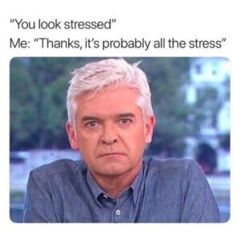
It is not necessary to have an extern involved in my opinion
Company Values
Providing emergency plans and (a) person(s) responsibility for it
Supporting Work-Life Balance
Evaluate the Status Quo
Notes:
ATMEN
CLICK
First of all: In my opinion it is not necessary to have an extern involved, at least to start with the topic, and a start is definitely more than doing just nothing
A start could be also making some people aware of this topic by raising it
This can be done by one person
CLICK
Providing emergency plans and at least one person or more who is or are responsible for it. I mean someone has to take care of agreements or anything else
Building up some kind of Mental Health Ambassadors for example
In my former company we got an extern company that is providing urgent help if needed. You can just write an email or call a number and you get help from professionals asap.
Not also for work related things but helping to deal with serious life situation where help is needed
CLICK
Company Values
Don’t just talk about it, write it down. Make sure everyone understands them and has an alignment from them
In my former company we got a confluence page where are company values are present and written down
In my current company we use them
If we are searching for a new employee, we not only focus on technical things but also on personal and social skills
Maybe we go out for dinner before recruiting someone fully
We are not doing just one talk but also doing a talk with the possible new employee with some team members
Including this in the decision making for someone we can see if the person is respecting our values and fits into our company
CLICK
Support Work-Life Balance
By looking out on the employers, maybe supporting sport programs, support after work events, respect free time, etc.
For example: We got Hansefit and urban sport club supported in my former company, so I could go at several gyms to getting my brain some free time
In my current company
we are doing some socializing event regulary that helps me at least to keep it steady in between doing “real” work and socializing
CLICK
Evaluate the Status Quo
Don’t be like: If I don’t know anything about it, it is not my problem!
Ask your employees about it!
Try to define the Status Quo to have a chance to change it if it is necessary
There are also some ready to send surveys for evaluation which can just be used
NÄCHSTE FOLIE

Slide 36
Well beeing at work
Employer
Colleauges
Myself
Notes:
I wanted to talk about Mental Health at work
My goal was to give you ideas to create a supportive workplace culture but also to establish some guidelines for you and for others
And I talked a lot about
In the beginning or in quite the beginning, I talked something about three parts to achieve what seems to be
The wellbeing at work
So
To summarize
Well beeing at work can be not achieved only alone or not by my colleagues or even the employer alone
For me it needs three pillars to build the house of well-being at work that influence it
CLICK
First of all the employer that builds the room for it and give the opportunities by defining, evaluating, asking and so.
CLICK
Second the colleagues that collaborate with each other and take the opportunities made from the employer and respect the frame that was created by the employer
CLICK
And last but not least myself that works at a company and collaborate with colleagues and is open to
Communicate problems openly and also makes space to support others.
So for me: These modell is necessary to build well-being at work
Try not to change you, change how you work and how you can fit into your work!
NÄCHSTE FOLIE

Slide 37
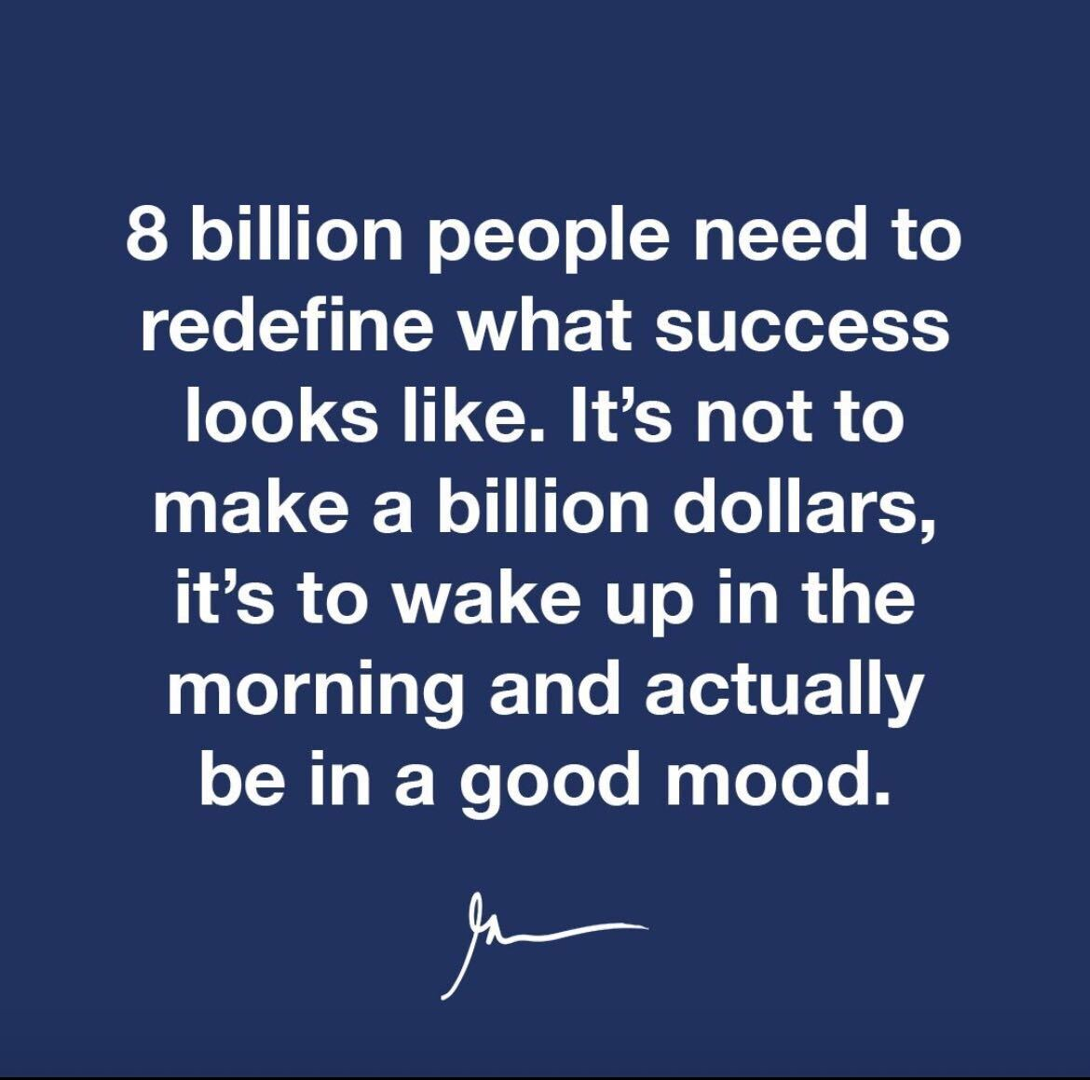
Notes:
I want to end this talk with something I found on the WWW and would be agree totally
NÄCHSTE FOLIE

Slide 38
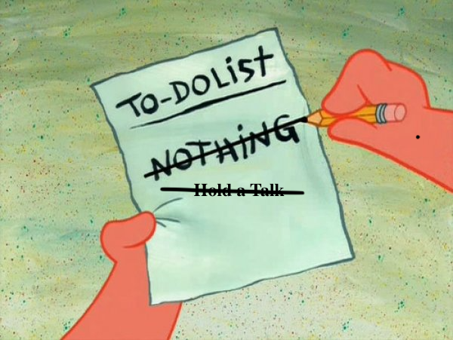
Thank you for
Listening!
Notes:
Thank you for listening!
NÄCHSTE FOLIE

Slide 39
Any questions?
Notes:
So, are there any questions?
BEANTWORTUNG DER FRAGEN
NÄCHSTE FOLIE

Slide 40
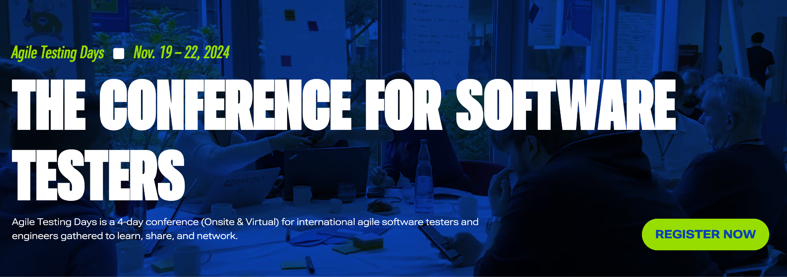
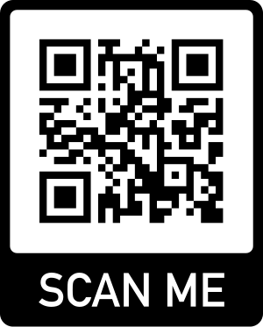
Takes place in Potsdam, Germany or virtual!
Speakers and Participants from all over the world
Notes:
Werbung für ATD
NÄCHSTE FOLIE

